Slide 1
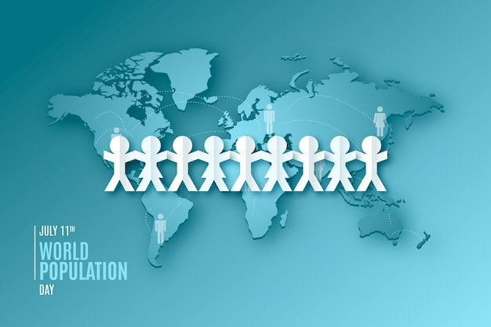
Global Economic and Demographic Trends Analysis A Power BI Data-Driven Report
SAKTHI ARAVIND K DA&DS
25/03/2024

Slide 2

Objective
Analyze population, GDP, health, and education indicators
Identify global trends from 1960–2017
Use Power BI to create a dynamic and interactive dashboard
Data Sources: SQL (CountriesWorld), Excel (Population, GDP, MetaData)

Slide 3
Datasets Overview
Excel Files :
PopulationPerCountry file contains the following columns:
▪ Country Name
▪ Country Code
▪ Indicator Name
▪ Indicator Code
▪ Population data from 1960 to 2017 for various indicators.
SQL Database (CountriesWorld file):
Country Code
Region
Population
Area (sq. mi.)
Population Density (per sq. mi.)
Coastline (coast/area ratio)
Net migration
Infant mortality (per 1000 births)
GDP ($ per capita)
Literacy (%)
▪ Phones (per 1000)
Arable (%)
Other (%)
Climate
Birthrate
Deathrate
Agriculture (% of GDP)
Industry (% of GDP)
Service (% of GDP)
MetaData file contains:
▪ Country Code
▪ Region
▪ Income Group
▪ Special Notes
▪ Country Name
GDP by Country 1960-2016 file contains:
▪ Country Name
▪ Country Code
▪ Indicator Name
▪ Indicator Code
▪ GDP data from 1960 to 2016.

Slide 4

Population Growth Insights
Africa and Asia Lead Global Growth :
Africa and South Asia experienced the fastest population growth between 1960 and 2017.
Nigeria's population grew by more than 5x
India grew from ~450 million to over 1.3 billion.
Developed Nations Show Stabilization :
Countries in Europe and North America show slow or stagnant population growth.
Germany and Italy even experienced slight declines in birthrates after 2000
Growth now depends more on migration than birthrate
Urbanized Nations Have Lower Birth Rates :
Countries with high urbanization and income levels have lower population growth rates
Japan, South Korea, and Canada
These countries are now facing aging populations and labor shortages
Population Density Increasing in Asia :
Despite land constraints, South and Southeast Asia face extremely high population densities
Bangladesh, India, and the Philippines are most affected
Raises concerns over housing, sanitation, and employment

Slide 5

GDP per Capita Comparison
High-Income Countries Lead Significantly :
Countries like Qatar, Luxembourg, and Norway consistently rank at the top in GDP per capita, exceeding $70,000–$100,000 USD.
Big Countries, Big Economies :
Singapore and Ireland have far higher GDP per capita than larger economies like India or Brazil.
Growth in Emerging Economies
China, Vietnam, and India show strong GDP per capita growth trends, especially after the 1990s.
Population Density :
Bangladesh and Taiwan are among the most densely populated
Australia, Canada: low density despite large land areas.

Slide 6

Population Density Extremes
Bangladesh and Taiwan have extremely high population densities, while countries like Australia, Canada, and Russia have low density despite large land areas.
Small Island Nations Show Extremes :
Monaco has over one of the highest globally.
Densely Populated Countries in Asia :
Countries like Bangladesh, Taiwan, and India have extremely high population densities — over 1,000 people per square kilometer in urban areas.

Slide 7

Global Improvement in Infant Mortality
Global Improvement in Infant Mortality :
The global infant mortality rate has decreased significantly since 1960.
In 1960, many countries had rates above 100 deaths per 1,000 births
By 2017, most countries brought this below 30 per 1,000.
Correlation with GDP and Literacy :
Infant mortality shows a negative correlation with GDP per capita and literacy rate.
The higher the GDP and literacy, the lower the infant mortality,
Areas of Concern Remain :
Some regions have shown slow progress or reversals, especially in conflict-affected or low-income areas ( Afghanistan, Yemen, South Sudan)

Slide 8
GDP Sector Composition
Service Sector Dominates in Developed Nations :
In high-income countries like USA, UK, Germany, and Japan, over 70% of GDP comes from the service sector.
Agriculture Drives GDP in Low-Income Countries :
In nations such as Ethiopia, Nepal, and Chad, agriculture contributes over 30% to GDP.
Balanced Economies Have Mixed Sector Strength :
Countries like China, India, and Brazil show a more even distribution between agriculture, industry, and services.
Industry Still Crucial for Some Economies :
countries like South Korea and Germany maintain a strong industrial base alongside services.

Slide 9
Conclusion & Recommendations
Major disparities in economic and health indicators across regions
Population and economic growth are uneven but improving
Literacy and healthcare access are key development drivers
Recommendations:
Invest in education to drive GDP
Improve healthcare in low-income regions
Diversify agriculture-heavy economies
Plan smart infrastructure in high-density countries
Focus on inclusive, sustainable growth

Slide 10
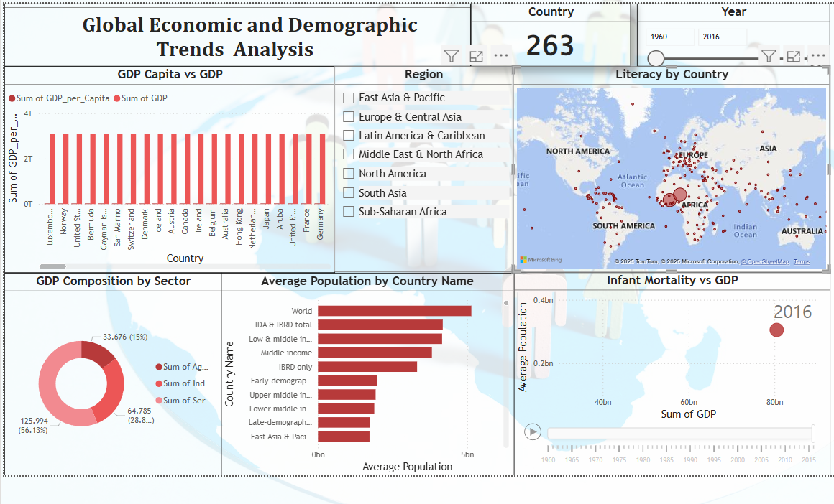

Slide 11


